Slide 1
Grey Wolf Optimizer
Seyedali Mirjalili, Seyed Mohammad Mirjalili and Andrew Lewis
Advances in Engineering Software, Volume 69, March 2014, Pages 46-61

Slide 2
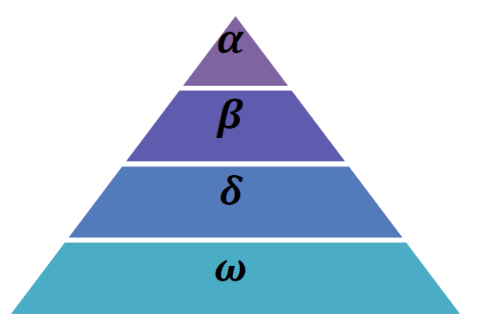
3.1. Inspiration
Grey wolves mostly prefer to live in a pack. The group size is 5-12 on average.
O Grey wolves have a very strict social dominant hierarchy

Slide 3
The leaders are a male and a female, called alphas
The second level in the hierarchy of grey wolves is beta
The lowest ranking grey wolf is omega.
If a wolf is not an alpha, beta, or omega, he/she is called subordinate (or delta in some references).

Slide 4
The main phases of grey wolf hunting
Tracking, chasing, and approaching the prey
Pursuing, encircling, and harassing the prey until it stops moving
Attack towards the prey

Slide 5
3.2. Mathematical model and algorithm

Slide 6
3.2.1. Social hierarchy
we consider the fittest solution as the alpha ( ). Consequently, the second and third best solutions are named beta ( ) and delta ( ) respectively. The rest of the candidate solutions are assumed to be omega ( )
In the GWO algorithm the hunting (optimization) is guided by alpha, beta, and delta. The omega wolves follow these three wolves.

Slide 7
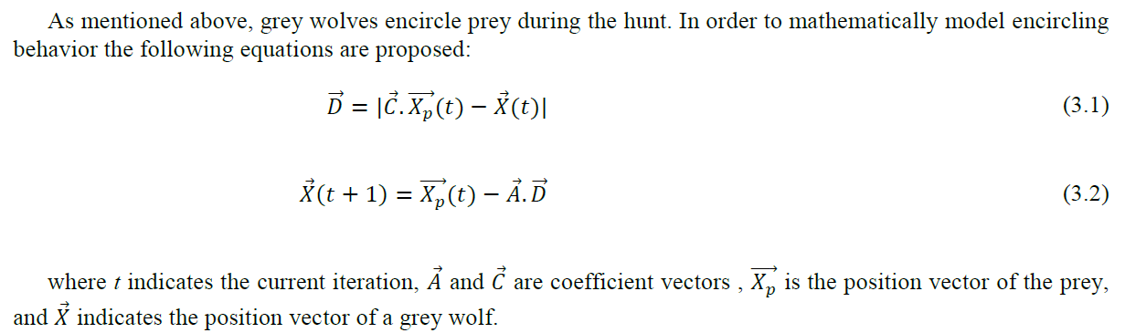
3.2.2. Encircling prey

Slide 8
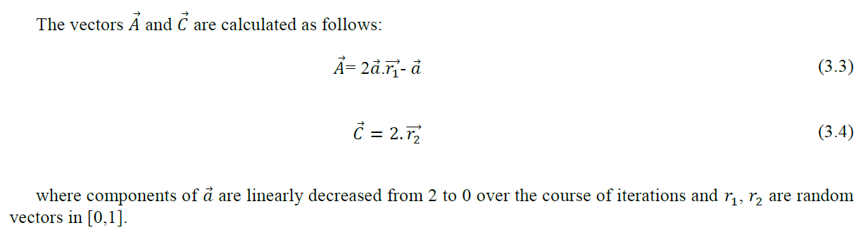

Slide 9
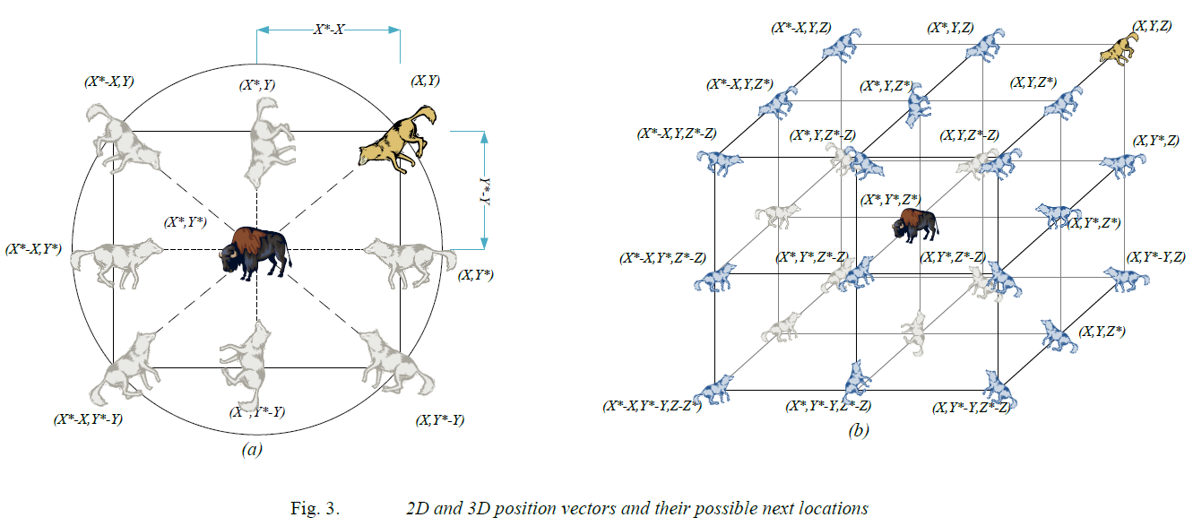

Slide 10
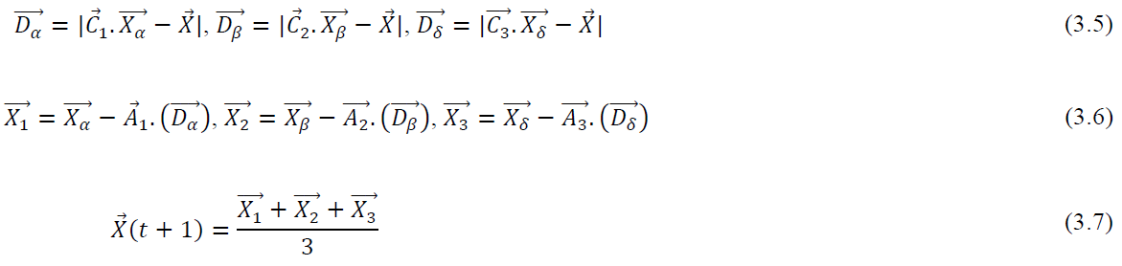
3.2.3. Hunting

Slide 11
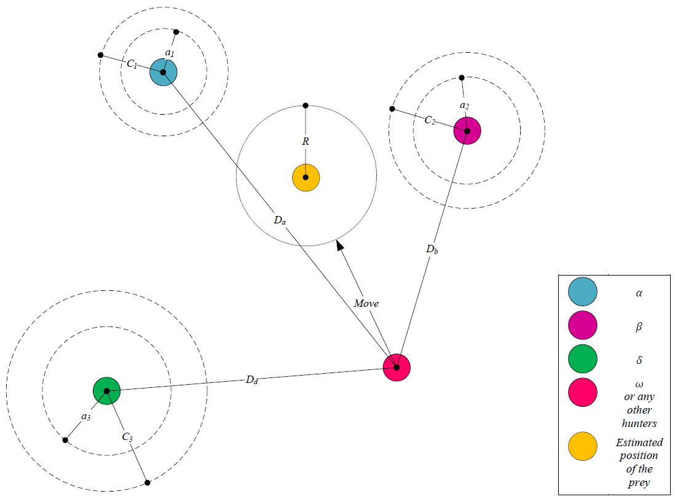

Slide 12
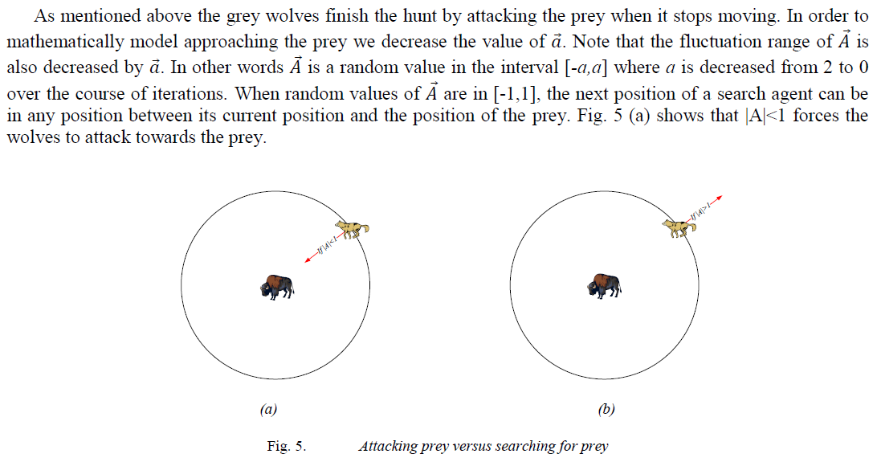
3.2.4. Attacking prey (exploitation)

Slide 13
3.2.5. Search for prey (exploration)
The parameter a is decreased from 2 to 0 in order to emphasize exploration and exploitation, respectively. Candidate solutions tend to diverge from the prey when |A|>1 and converge towards the prey when |A|<1.

Slide 14
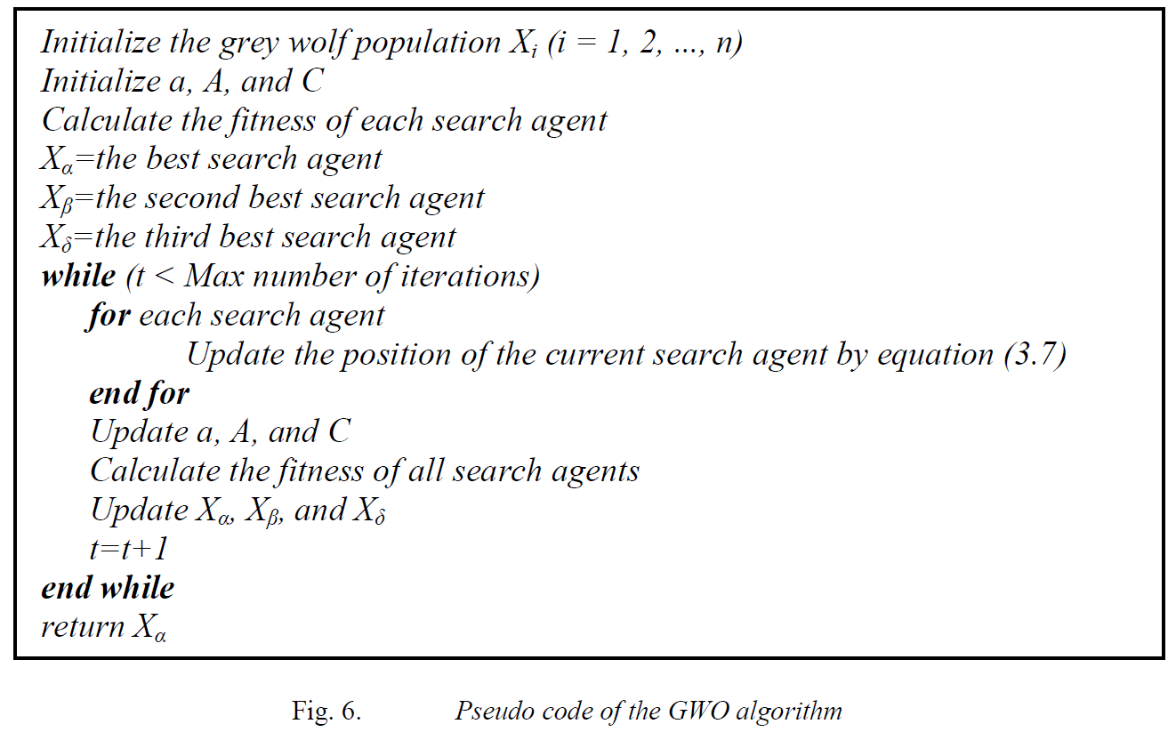

Slide 15
The proposed social hierarchy assists GWO to save the best solutions obtained so far over the course of iteration
• The proposed encircling mechanism defines a circle-shaped neighborhood around the solutions which can be extended to higher dimensions as a hyper-sphere
• The random parameters A and C assist candidate solutions to have hyper-spheres with different random radii
• The proposed hunting method allows candidate solutions to locate the probable position of the prey

Slide 16
• Exploration and exploitation are guaranteed by the adaptive values of a and A
• The adaptive values of parameters a and A allow GWO to smoothly transition between exploration and exploitation
• With decreasing A, half of the iterations are devoted to exploration (|A|≥1) and the other half are dedicated to exploitation (|A|<1)
• The GWO has only two main parameters to be adjusted (a and C)

